Slide 1


Slide 2


Slide 3

Arduino Workshop
Notes:
https://www.arduino.cc/en/Main/Software

Slide 4
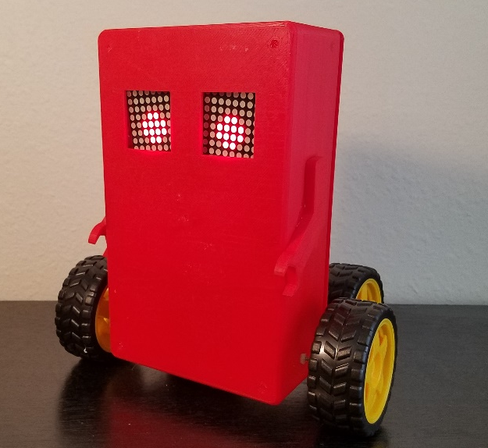
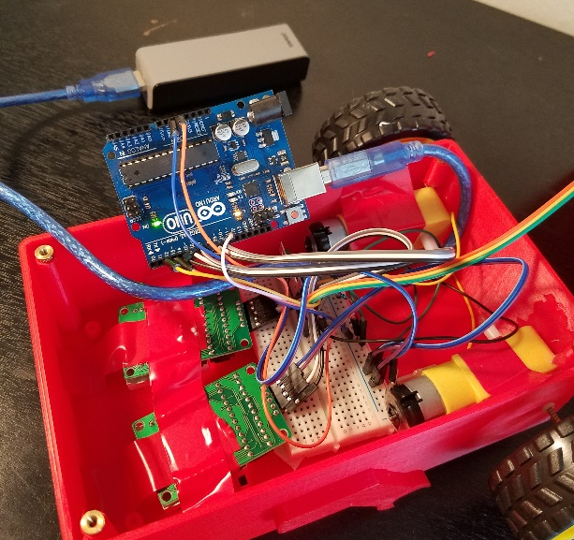
What is Arduino?
A programming language made to integrate hardware with software in a way that is easy for anyone to learn and utilize
Works seamlessly with an Arduino board to allow for almost limitless building capabilities
Is an object orientated language that is similar to C++

Slide 5
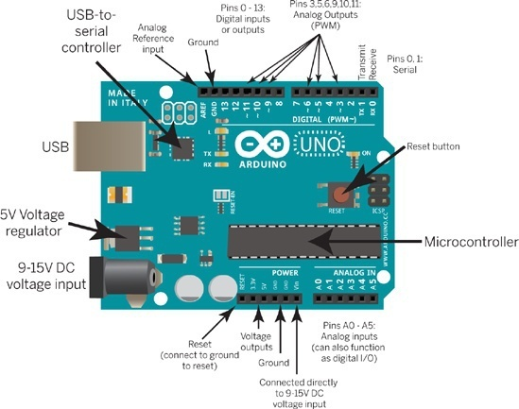
Brief explanation of the Arduino uno
Notes:
https://www.arduino.cc/en/Reference/Board

Slide 6
Variables, declaration, and assignment
“int” represents an integer
“double” or “float” represents numbers with fractional components, like a decimal but double can hold higher values
“bool” represents Boolean variables, that can be either True or False
Declaration is when you “declare” a variable’s type
Declaration must be made before assignment is possible
You can declare variables with “#define variableName #” and it will stay constant throughout the program
Assignment just assigns a value to the variable you’ve created
Notes:
https://www.arduino.cc/en/Reference/VariableDeclaration

Slide 7
Math time!
+ represents addition
- represents subtraction
* represents multiplication
/ divides (for integers, it rounds down)
% represents remainders for integers
11%2 = 1 because 11/2 is 5 remainder 1
++ adds one to the variable to the left of it
-- subtracts one from the variable to the left of it
= is the assignment operator
Notes:
https://www.arduino.cc/reference/en/language/structure/arithmetic-operators/addition/

Slide 8
Variables and Math example
//by the way this is a comment that will last to the end of the line
//the compiler ignores these comments, they are for the programmer
/* This is a comment that will span as long as you want it to until the * terminating character is reached, this is a good way to test what * part of your code is broken, by commenting out different sections of * code */
int x;
x = (3 * 2) % 3;
x++;
bool wicseMember = True;

Slide 9
True or false?
Used in conditional statements, to check if a condition applies
&& represents logical AND and returns true when both conditions are true
|| represents logical OR and returns true when at least one of the conditions are true
< or > are less than and greater than respectively
<= and >= are less than or equal to and greater than or equal to respectively
== represents equal to (= is used to assign values, not test equality)
!= represents not equal to
Notes:
https://startingelectronics.org/software/arduino/learn-to-program-course/12-logical-operators/

Slide 10
If statements and else statements
if (this condition is true)
{
Do these statements;
}
else
{
Do these statements;
}
if conditions can exist independently, but else statements cannot
Notes:
https://www.arduino.cc/reference/en/language/structure/control-structure/if/

Slide 11
For statements
for (start with this statement; while this statement is true; change in this way)
{
Do these statements;
}
Very common to have an iterator (i), that does the statements a certain number of times
You can leave out aspects of the for loop if you don’t need them, just leave the semicolon
Notes:
https://www.arduino.cc/reference/en/language/structure/control-structure/for/

Slide 12

Arrays
Arrays are a type of data structure, they hold pieces of data that are arranged sequentially
A set of a specific data type, like a set of “int”s, “float”s, ect.
Have a set size that can be not be changed after declaration
Notes:
https://www.arduino.cc/reference/en/language/variables/data-types/array/

Slide 13
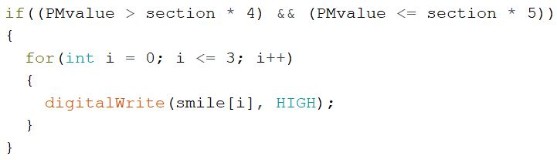

Slide 14
Classes and objects in Arduino
Libraries are very plentiful on Arduino for many types of input and output
Many of these libraries are built into the language, so it saves you the trouble of looking for them
Classes are contained in libraries, and declarations of these classes are called objects
With these objects often come useful functions and properties
the “.” operator is an easy way to use these features
Notes:
https://www.arduino.cc/en/Hacking/LibraryTutorial

Slide 15
Common input and output
pinMode(pinNumber, INPUT); and pinMode(pinNumber, OUTPUT);
int digitalValue = digitalRead(digitalPin);
Digital pins have a ~ next to their number
digitalWrite(pinNumber, HIGH); and digitalWrite(pinNumber, LOW);
int analogValue = analogRead(analogPin);
Reads in a 10 bit word, a value from 0 to 1023
Notes:
https://www.arduino.cc/en/Tutorial/AnalogInput

Slide 16
Functions
All Arduino programs start with two functions: setup() and loop()
“void” before the functions means that it will not return anything
empty parenthesis means that it accepts no parameters
setup is used for instantiating variables, declaring pins as input or output, and other start up work required for objects
Variables declared here are unusable to loop() as they are local variables
loop is the main part of your program, and its contents will be repeated potentially forever
Notes:
https://www.arduino.cc/en/Reference/FunctionDeclaration

Slide 17
DIY functions
You can make your own functions to prevent repetitive coding
Function declaration declares the return type as well as the type and number of parameters followed by a semicolon
Usually near the top of a program
returnType functionName (paramType paramName, paramType2 paramName2);
int quadratic(int a, int b, int c);
The function definition MUST be identical to the declaration, but instead of a semicolon it has a body enclosed by curly brackets
A function call is a use of the function, where the return value can be saved to a variable and the parameters must all be of the same type and quantity.
int answer = quadratic(1, 3, 2);

Slide 18

Trying to learn an entire programming language in an hour

Slide 19
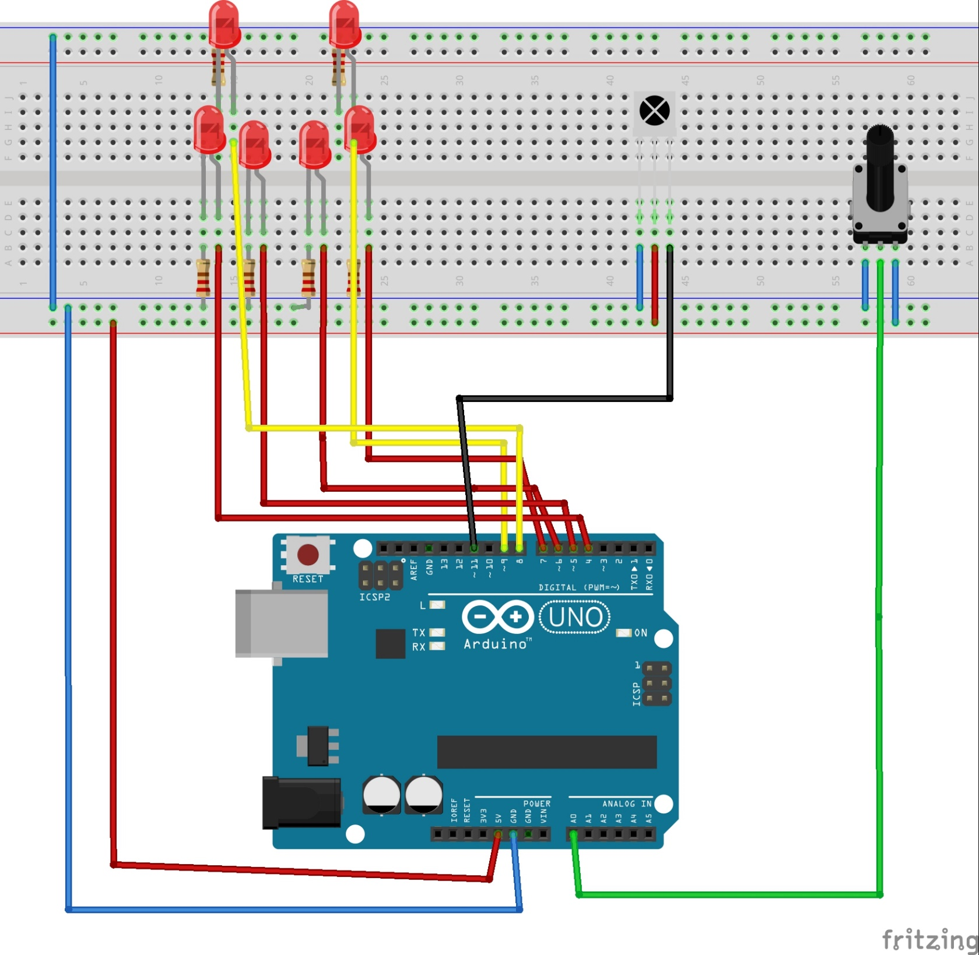

Slide 20
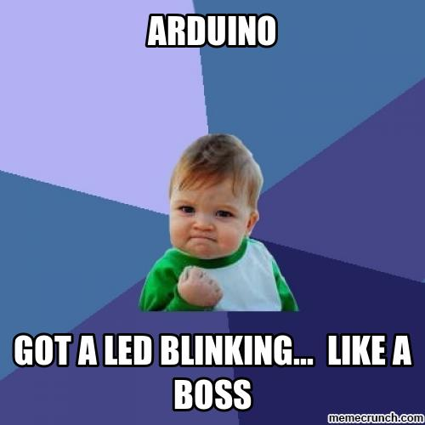
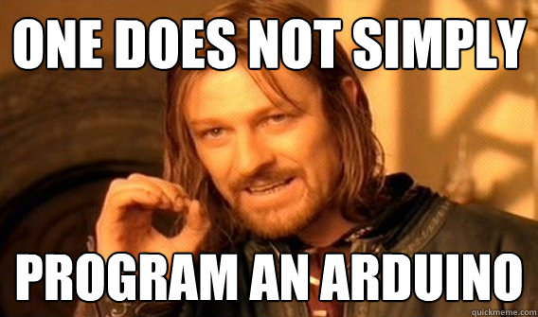
Resources
Arduino’s reference website: https://www.arduino.cc/reference/en/
DFX Lab: http://www.eng.usf.edu/dfx/

